Slide 1
Deliverable 2
Adam Afilaka: Developer/Programmer
Ashley Braun: Business Analyst/Project Manager
Zaid Islam: Cyber Security Engineer
Rithika Sayini: Researcher/Programmer
Shanese Scott: Database Administrator
Xin Zheng: Quality Assurance

Slide 2
Requirements Definition Document: Functional Requirements
1
Process-Oriented | Information-Oriented
The system should allow doctors to view a patient’s medical records The system must collect recent health data and store it in a database The system must be able to track user response time | The System must retain a patient’s full medical history The system must include real-time health updates The system must include history of authenticated users

Slide 3
Requirements Definition Document :Non-Functional Requirements
2
Operational | Performance | Security | Cultural and Political
The system will run on Android and iOS devices The system should be able to easily integrate with existing databases The system must be compatible and optimized to work with multiple EMR devices | Patient information should be available to view 24/7 The system needs to be able to support millions of user data. Doctors should be able to view patient data in seconds Response and refresh times should be shorter when processing queries | Only authorized users should be able to access patient data Ensuring data encryption for database tables Make sure that inactivity timeouts and login requirements are met | Patient information should be compliant with the Data Protection Act The system needs to be accessible worldwide The HITECH Act

Slide 4
Interview
Johns Hopkins Hospital: It was a fairly simple process for contacting someone who works at Johns Hopkins Hospital as an applications coordinator for Epic Systems. We chose to interview a JHH employee because they can provide thorough knowledge about how they store, encrypt, and access their user medical information. The interview itself went very smoothly, and it provided us with the knowledge we need to create our device.
Senior Physician: Interviewing the physician gave the team ideas about having back up plans since the daily life of the individual will require 2 step verification since these are human beings lives. We were on the right track with concussion responses . The pregnancy scencerio if possible would be better with a belt application that would allow the device to track contractions. During an emergency where cell phone towers are down, a method of communicating an emergency would be using citizen bands that allow for radio communications. Also our data is quite important that is sought after.

Slide 5
Question #1
Q: Let us say that a person using our EMR device has a career that requires them to be constantly on the move. Every time their heart rate spikes the natural response for the device would be to alert them of their change in homeostasis. This would become redundant after a while. How can we implement the heart rate function to learn from the User’s patterns?
A: Use artificial intelligence and advanced neural network to analyze the changes in the body. The EMR device would have to learn from the user’s patterns by building a trend report of some type. Take the application Flo for example. This application tracks female cycle changes by building a trend report. Based on this, it can accurately predict the next day of ovulation and begins counting down from that day - JHH
A: If possible I would like to be aware of the patient’s schedule. So if its a redundant process it should be included in the schedule but even if it is on schedule a spike should be followed by a notification from the device just to make sure or a check from the device to make sure the patient is ok. If unresponsive, call emergency services - SP

Slide 6
Question #2
Q: Would it be a good idea to implement a function that tests response time for a user that just underwent a major accident, such as a concussion? For example, if the user’s vital levels drastically change due to a concussion, the EMR device displays a screen stating “Are you responsive; Yes or No.” If the user does not respond within 10 seconds the device notifies 911 and their PCP.
A: It would be effective to implement a function like that. However, from experience, a response within 10 second is effective only if the user knows that they have to acknowledge the device. Therefore, consider implementing an alarm system during situations like these so that the user cannot ignore the alert - JHH
A: That’s exactly what I would recommend, could not say it better myself - SP

Slide 7
Question #3
Q: How do you feel about tracking oxytocin levels with pregnant women, so when the woman is about to give birth, the EMR device is aware of the sudden spike in hormone levels? Would you say this is an efficient method for detecting hormone changes or is there a method that is easier to measure?
A: The two main reasons for oxytocin release would be due to childbirth and lactation. Of course the device would need to be able to distinguish these different processes. Tracking would be an effective method for determining large spikes to differentiate between the two. Implementing loops into the code for your device would alert the user that they will have contractions if their hormone levels have spiked. This logic can be used to various other parts of the endocrine system - JHH
A: The oxytocin level is evasive since it goes up and down a lot and could lead to a lot of false positives. The most reliable thing to measure is contractions since 1 in every 5 minutes is the tell tell sign to go the hospital if a belt around the belly for pregnant women only than I would recommend that instead - SP

Slide 8
Question #4
Q: That leads me to my next question about which alert system you would find to be the most reliable for emergency services and for medical centers. What about when cell phone services are down like in a natural disaster.
A: Implement some type of technology that works the same as LifeAlert emergency response device. A way to communicate through radio or even using the bluetooth all around us for peer to peer communication - JHH
A: Tricky, so for emergency services like police, firefighters, and EMTs they have a radio band systems in order to communicate when cell phone services are down. I believe channel 9 is reserved for emergencies. So if your device is able to use that channel that would be useful in a natural disaster - SP

Slide 9
Question #5
Q: What do you believe would be the best way to encrypt user medical records on this device so that only the user and their PCP will have access to it?
A: To properly encrypt PHI, identify where the PHI enters your device to determine where to start encrypting. I suggest researching how hospitals encrypt their patient information and what companies they’ve hired to do so - JHH
A: I’m not well versed on the topic of encryption but I would recommend passwords be kept very confidential since real time data is very valuable, corporations like Google and Amazon would benefit from that sort of patient data - SP

Slide 10
Use Case Analysis
UC- 1: Record Patient’s Current Vital Sign
The patient’s vital signs are constantly being collected by this device, and when anything abnormal happens, it will alter the patient’s data. For example, when there is an abnormal heartbeat is record, it will send warning to patient for potential heart attack .
UC - 2: Request medical records and vital signs data
If the patient is having an adverse health event and in a loss conscious state, the data of medical history and vital signs can be exported into ER’s system by the request of doctor. It will help the doctor to diagnose the patient more accurately.
UC - 3: Oxytocin Hormone Changes in Patient
If the patient is having spikes in oxytocin hormone levels during certain processes such as childbirth or lactation, the device should be able to record this change and alert the user. This will also alert the user if they are about to undergo early childbirth.

Slide 11
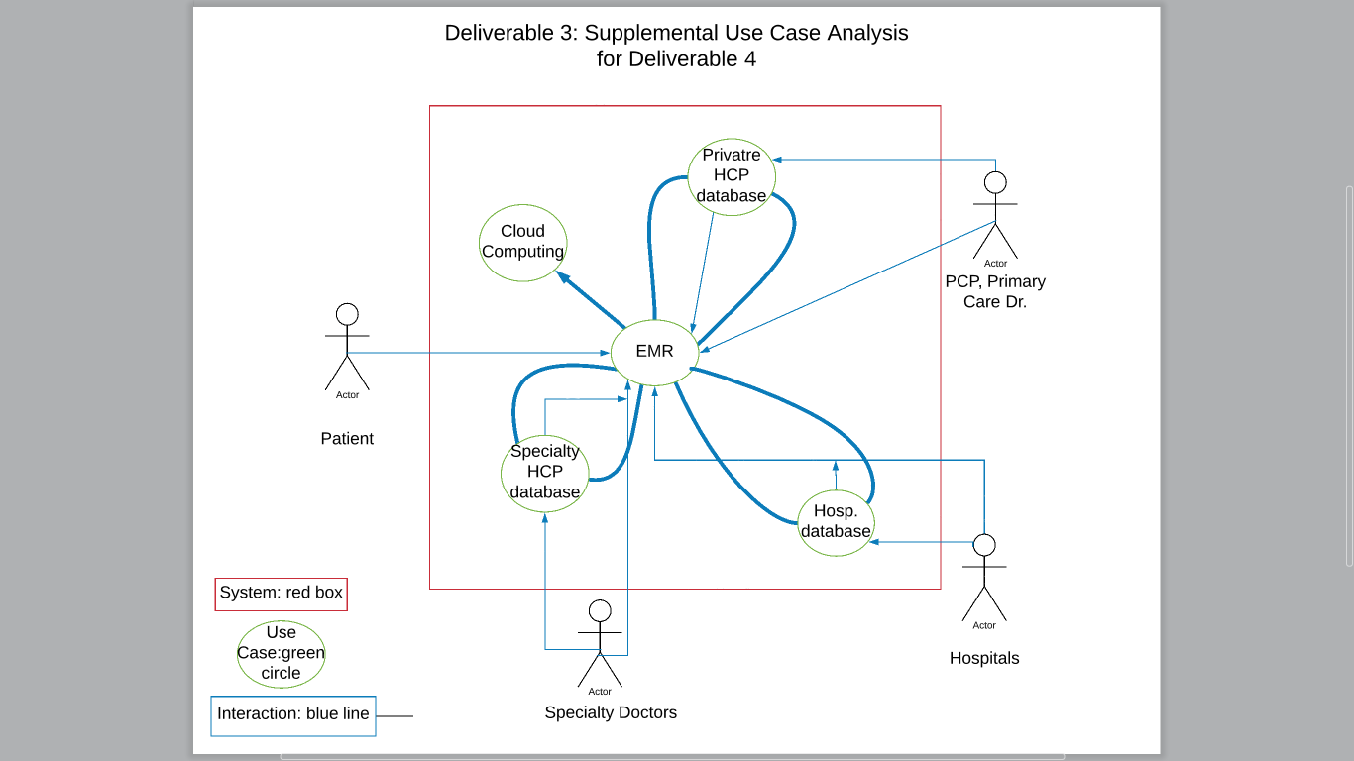
Use Case Diagram

Slide 12
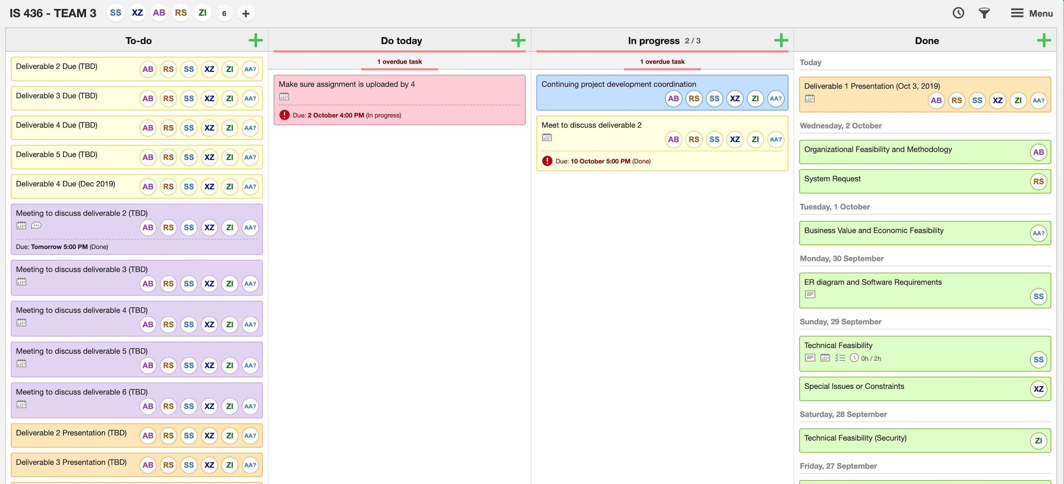
Kanbanflow

Slide 13
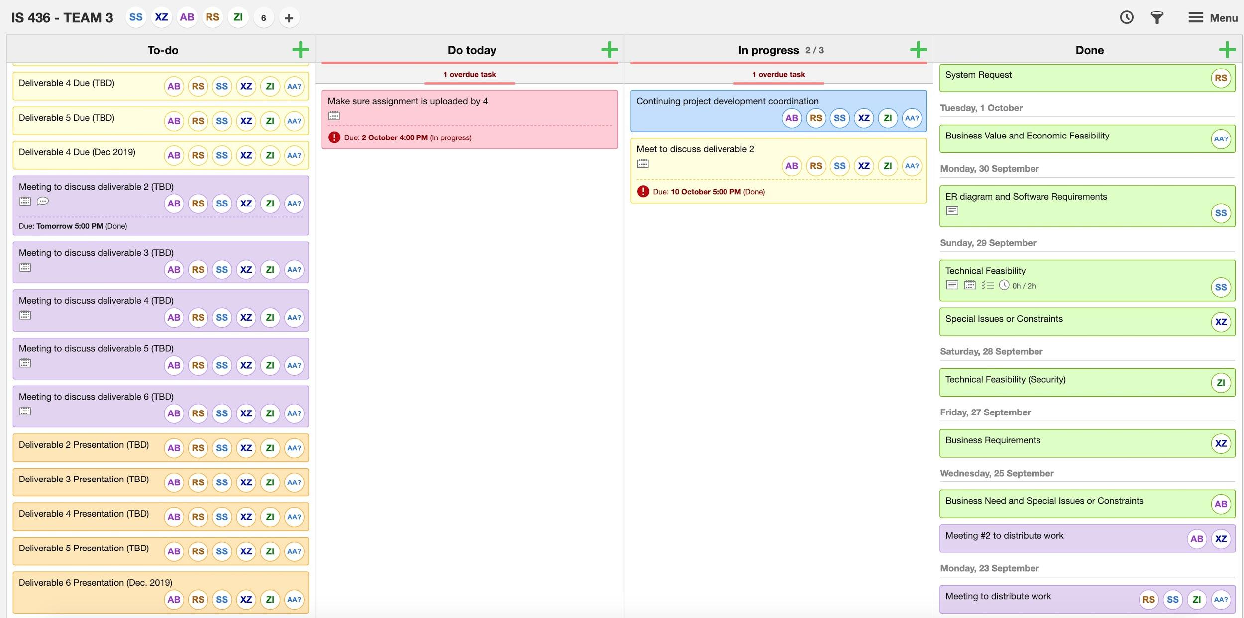
Kanbanflow cont.

Slide 14
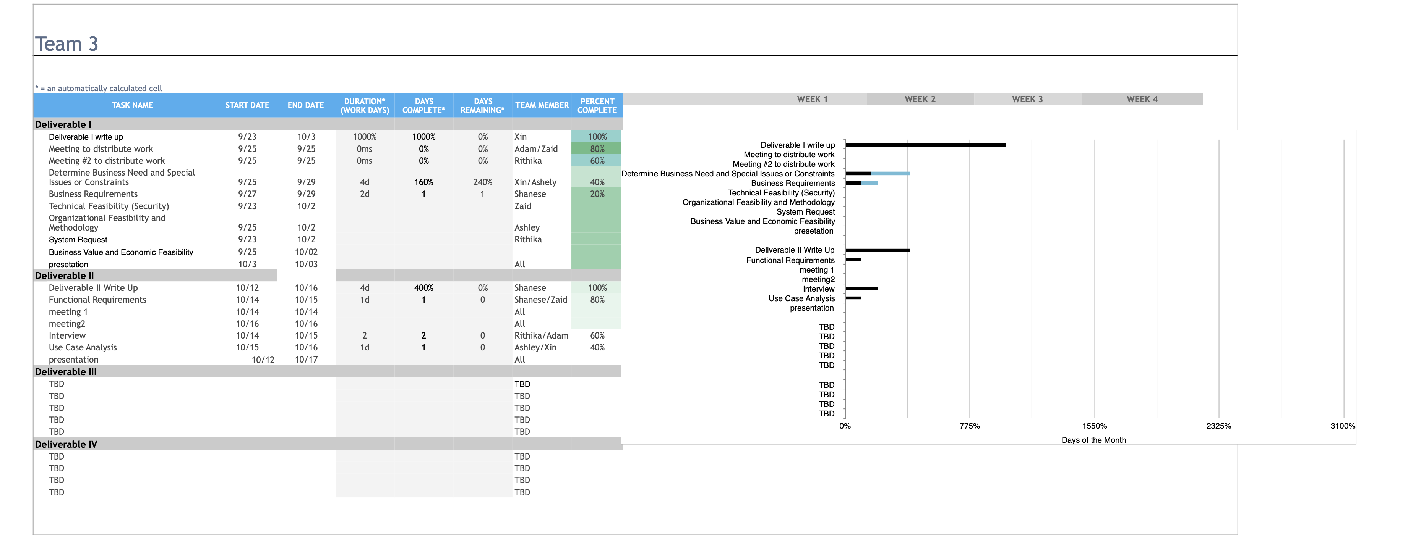
Gantt Chart

